Slide 1
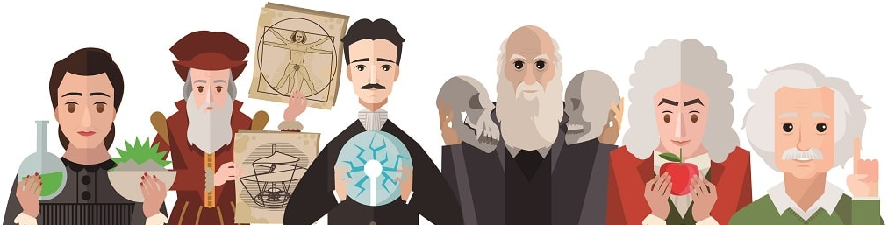
The role of scientists in society

Slide 2
Presentation plan
Who are scientists and what do they do?
The key features of scientists
Types of scientists
The responsibilities of scientists
Conclusion

Slide 3
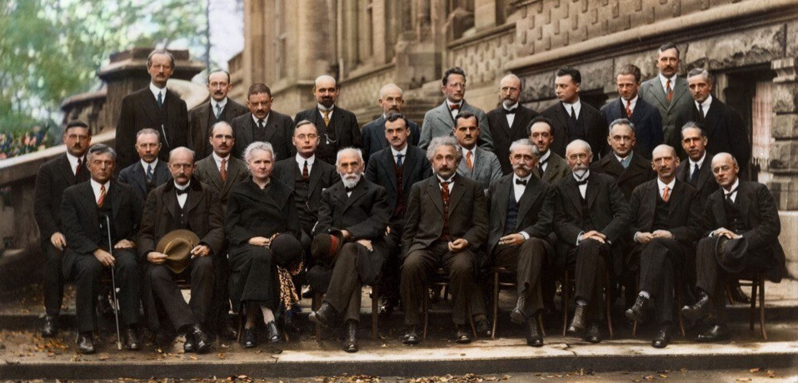
Who are scientists and what do they do?
The 1927 Solvay Conference

Slide 4
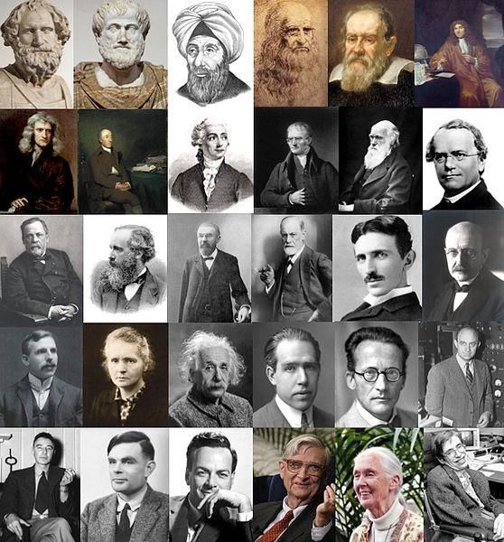
The key features of scientists
Curiosity
Skepticism
Objectivity
Persistence
Critical thinking
Creativity

Slide 5
Types of scientists
Theorist | Experimentalist
Focus: Develops models, theories, and predictions using mathematics and existing data. | Focus: Tests hypotheses through hands-on experiments, observations, and data collection.
Workplace: Often at a desk, using computers for simulations and calculations. | Workplace: In a laboratory, in the field, or at a particle accelerator.

Slide 6
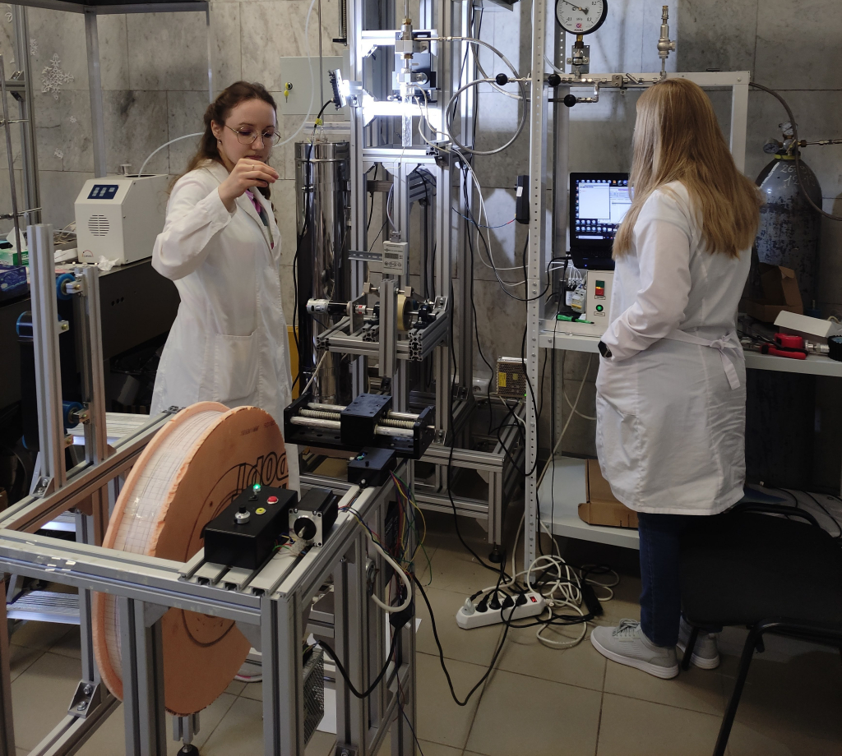
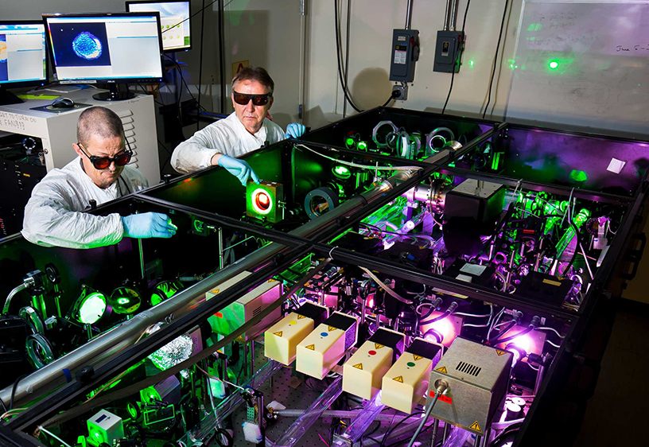
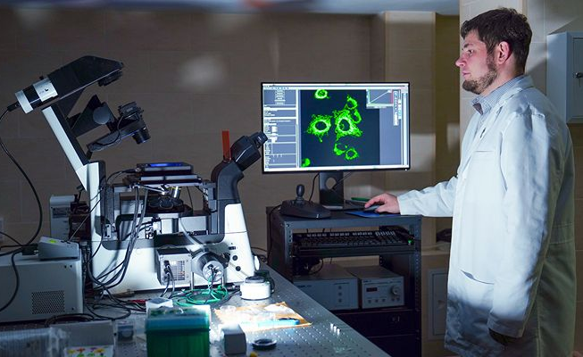

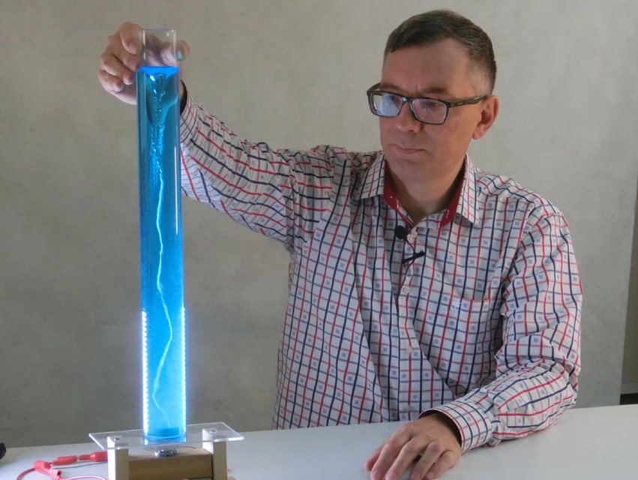
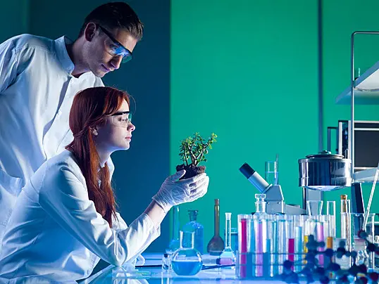
The responsibilities of scientists

Slide 7
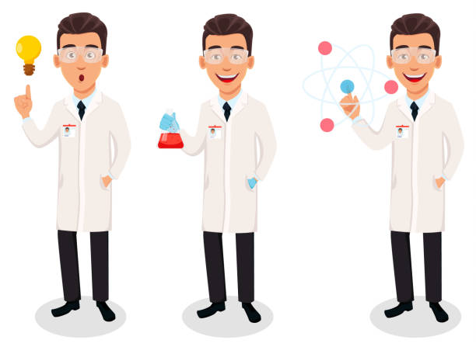
Conclusion

Slide 8
Thank you for your attention!

